Slide 1







3

Slide 2
Back to Game
Restart Game
Save Game
Exit Game

Slide 3
Go to Main-Menu

Slide 4


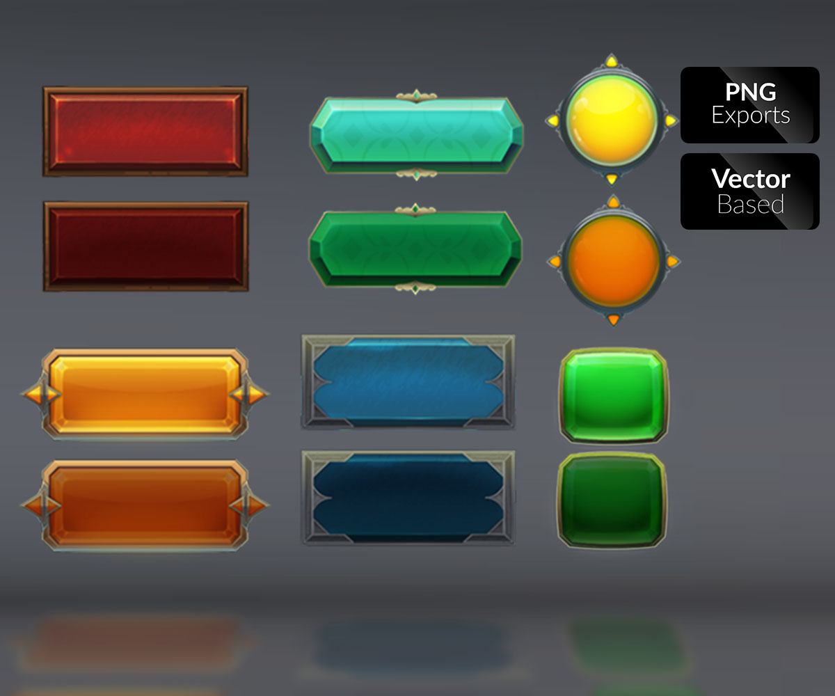



Slide 5
3
4
5
1

Slide 6
1
2
3
4
5
6

Slide 7
Choose option to Save
1
2
3
4
5
6

Slide 8
Back to Pause Menu

Slide 9

1
2
3
4
5

Slide 10
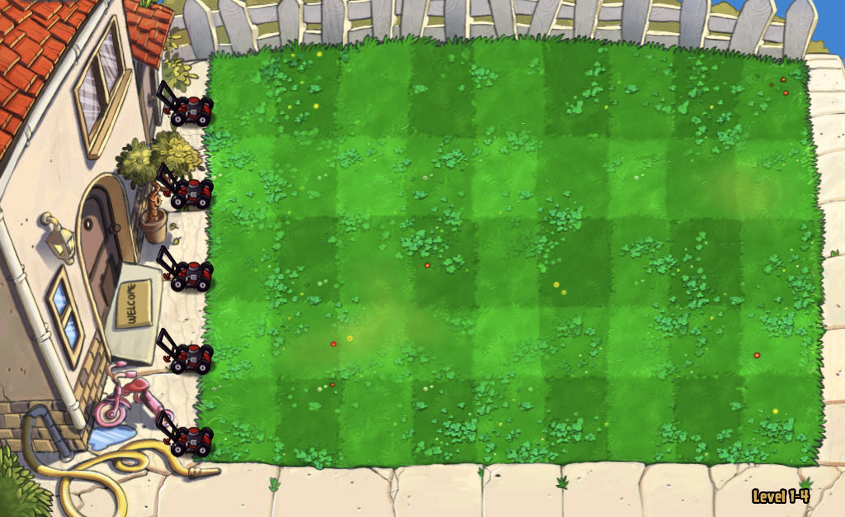
Made by – Himanshu and Udit

Slide 12
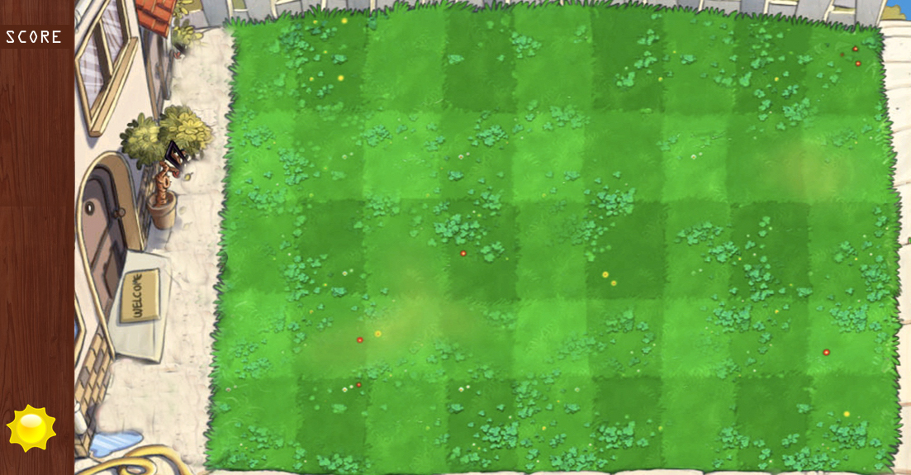

Slide 13
SAVE
RESTART
LOAD GAME
NEW GAME
EXIT

Slide 14
CHOOSE LEVEL

